Slide 1


SabFaltu
July 2024
PROJECT
SATTRA

Slide 2
SabFaltu
July 2024
Product summary
THE PRODUCT?
An Innovative desktop application for small and medium healthcare facilities.
With focus on efficiency, efficacy, and excellence in healthcare management

Slide 3




SabFaltu
July 2024
WHO
ARE OUR
Its Everyone!
STAKEHOLDERS?

Slide 4

SabFaltu
July 2024
What is it built with?
Key Values
Following the OpenSource model, it utilizes the Flutter framework along with PostgresSQL to achieve the goals of management
Flutter Framework
Dart Language
Supabase / PostgreSQL

Slide 5

SabFaltu
July 2024
Distinct user roles and Fluent UI design cater to intuitive usage.
Modules cover Patient Management, Medicine Tracking, Appointment Scheduling, and Report Generation, ensuring comprehensive healthcare management.
Flutter
Dart Programming

Slide 6

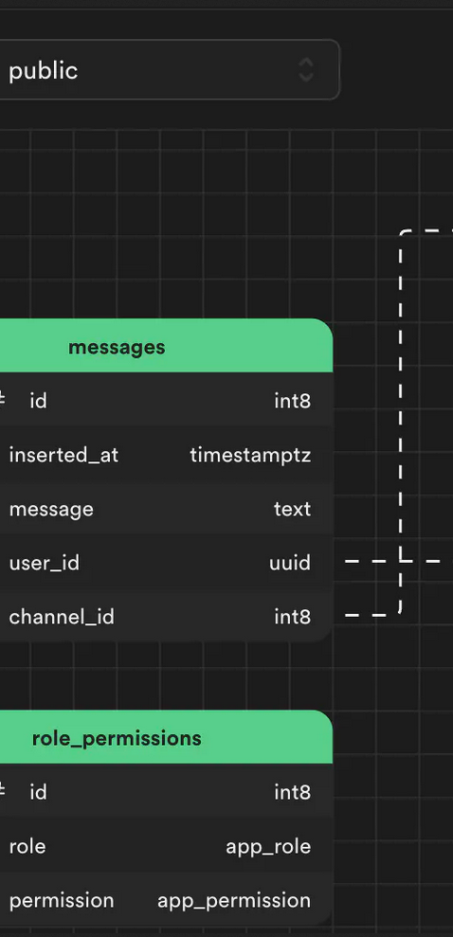
SabFaltu
July 2024
Why Supabase?
Supabase was chosen for its robust online database storage and synchronization capabilities, ensuring seamless data management across devices and users.

Slide 7

SabFaltu
July 2024
Database Implementation
A relational database design, Supabase for online storage, and PostgreSQL for local storage form the backbone. Integration of Windows UI scheme ensures visual consistency and user familiarity.

Slide 8
SabFaltu
July 2024
WHAT PROBLEM DOES THIS PRODUCT FIX?
What is its magic?

Slide 9
Another idea, equally important
SabFaltu
July 2024
How we'll measure success
This is what we bring to the table
Secure user roles & permissions.
Customizable report generation
Intuitive Fluent UI design.
Integration with EHR & billing
Patient & Medicine management
Real-time data sync
Dynamic appointment scheduling
Performance Optimization
Automated reminders
Enhanced Security Measures

Slide 10



SabFaltu
July 2024
Wny Fluent UI
Fluent UI was selected for its familiarity to Windows users, ensuring ease of navigation and usability across the application.

Slide 11
Another idea, equally important
Milestones
SabFaltu
July 2024
Stage 1
Stage 2
Stage 3
Party
Build it
Do it
Test it
Deliver it
Use it
Kick off
Development
Go / No go
Launch
Comprehensive testing, including unit testing, integration testing, and system validation, ensures reliability and performance. From automated unit tests to user acceptance testing, each phase verifies functionality and usability.

Slide 12
SabFaltu
July 2024
Product summary
WHAT IS IN THE FUTURE?
Potential enhancements include server database setup, user training, and performance optimization, prioritizing continuous improvement and community engagement.

Slide 13
SabFaltu
July 2024
Free
Enterprise
Custom Scaling based on Infrastructure.
Cloud backup and Storage based on pricing.
Use the product Locally.
Enjoy 2Gb of cloud syncing

Slide 14
SabFaltu
July 2024
“
Sattra achieves milestones in database design, UI integration, and testing. While facing knowledge imbalances and time constraints, it sets the stage for future enhancements like server setup and user training, promising continued improvement in healthcare management
— Professional Designer

Slide 15

SabFaltu
THE END

